Slide 1
Data & Cloud Skill Up and Exam Ready Workshop Exam 70-535: Architecting Azure Solutions
Coach Culbertson
Friendly Neighborhood Instructor
Directions Training
Damon Ronco
Azure Technology Solutions Professional
Microsoft
Guest Star
Dan Stolts
IT Pro Guru

Slide 2
Agenda – Day 1
Time | Speaker | Topic
8:30 AM |  | Registration and Breakfast
8:45 AM | Damon | Welcome Remarks
9:00 AM | Coach | Agenda Overview
9:15 AM | Dan Stoltz | Becoming a Cloud Architect & DevOps 70-535-DevOps-and-NextSteps.pptx
10:30 AM | Break
10:45 AM | Coach | Operational Readiness 70-535-Design-For-Operations.pptx
11:30 AM | Coach | Compute Infrastructure70-535-Design-Compute-Infrastructure.pptx
12:30 PM | Labs/Lunch/Networking
1:30 PM |  | Security & Identity Solutions 70-535-Design-Security-and-Identity-Solutions.pptx
2:45 PM | Damon | Data and Storage70-535_02-Design Data Implementation.pptx
4:00 PM |  | Making it Real with Practical Application—Open Discussion

Slide 3
Agenda – Day 2
Time | Speaker | Topic
9:00 AM |  | Registration and Breakfast
9:30 AM | Coach | (Super Happy Fun Bonus Time—Certification Secrets) Platform Services
11:00 PM | Break
11:15 AM | Coach | Platform Services
12:30 PM | Labs/Lunch/Networking
1:30 PM | Damon | Networking
2:45 PM | Break
3:00 PM | Everybody | Making it Real with Practical Application—Open Discussion
4:00 PM |  | Wrap-Up/Closing Remarks

Slide 4

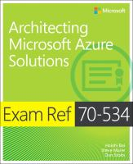
Exam Jump Start 70-535 Architecting Microsoft Azure Solutions DevOps and Next Steps
Dan Stolts - Author
Chief Technology Strategist, Microsoft
http://ITProGuru.com
http://ITProGuru.com/join
http://LinkedIn.com/in/danstolts
ITProGuru@Microsoft.com
@ITProGuru
Get Invited…
ITProGuru.com/Join
Microsoft Virtual Academy
Notes:
http://aka.ms/certification/70-534
https://mslibrary.measureup.com/

Slide 5
Architect Defined
Given Challenge
<=>
Create Solution
Noun:
1. a person who designs and in many cases also supervises construction
2. the deviser, maker, or creator of anything: the architects of the Constitution of the United States.
Verb:
4. to plan, organize, or structure as an architect: The house is well architected.

Slide 6
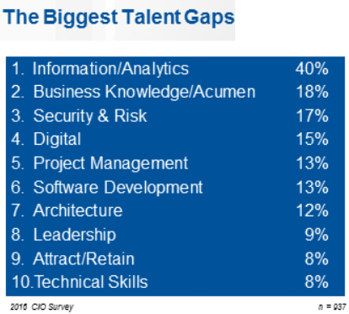

2016 CIO Priorities & Challenges
Talent has now been recognized globally as the single biggest issue standing in the way of CIOs achieving their objectives.
The biggest talent gaps are around Information/Analytics followed by business knowledge/acumen.
Understanding what is possible with the cloud can help close the gap
http://www.gartner.com/imagesrv/cio/pdf/cio_agenda_insights_2016.pdf
Notes:
http://www.gartner.com/webinar/3139617/player?commId=175277&channelId=5500&srcId=1-2973089105

Slide 7


Translate Business Objectives Into Actions
Identify Problems (especially root problems)
Determine the requirements to solve each problem
Determine technology available to help solve the problem
Identify strategic partners
Determine likely barriers
Determine additional value (if any)
Get Started

Slide 8






DevOps is the union of people, process, and tools to enable continuous delivery of value of our end uses.
DEV
OPS
1
People
2
Process
3
Tools
Shared Mission: Deliver a great product that inspires our customers to become raving fans
Notes:
People = Culture
Fundamental attributes of successful cultures:
Shared mission and incentives: infrastructure as code, apps as services, DevOps/all as teams
You need to consider your hardware as a commodity, (don't give your servers names) , servers are like farm animals, it is just harder if you let theids name them
Build deep instrumentation into services, push complexity up the stack
Rally around agile, shared metrics, CI, service owners on call, etc.
Changing the culture: any change takes time, changing culture is no exception and you can't do it alone, exploit compelling events to change culture: downtimes, cloud adoption, devops buzz
PROCESS Definition and design, compliance, and continuous improvement
PEOPLE Responsibilities, management, skills development, and discipline
Tools and infrastructure

Slide 9
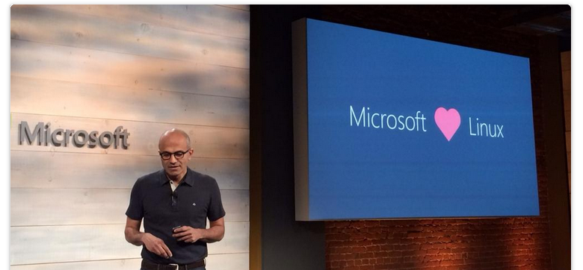
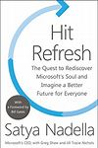
Culture Change & Digital Transformation
Hit Refresh
The Quest to Rediscover Microsoft's Soul and Imagine a Better Future for Everyone
2017 - Satya Nadella, Greg Shaw, Jill Tracie Nichols - Biography & Memoirs

Slide 10
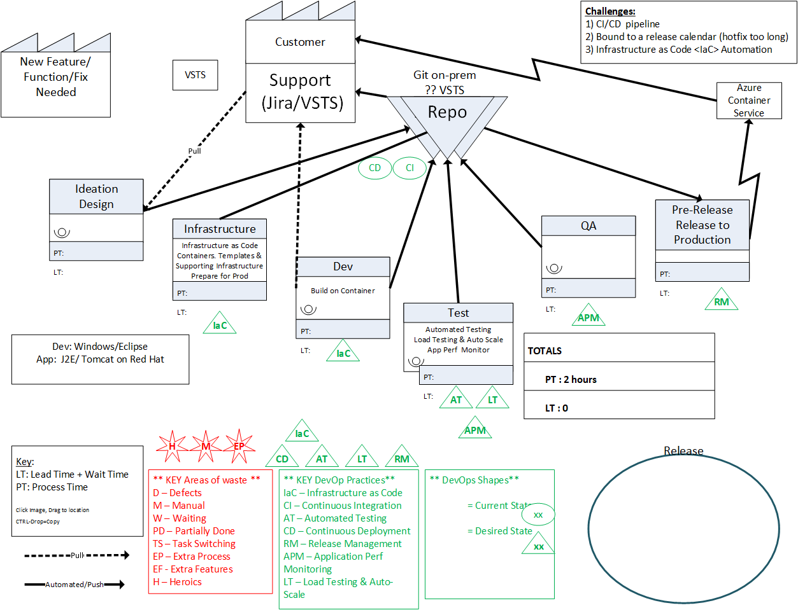
Value Stream Mapping – Understanding and Teaching

Slide 11
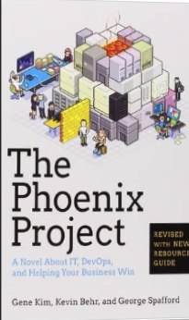
Tip: Must Read Book
Amazon…
The Phoenix Project: A Novel about IT, DevOps, and Helping Your Business Win Paperback
– October 16, 2014
The book is available on Audio Book; you can likely get it for free, if you do not already have an account. If you do not have an Audible Account, you get two free books when signing up for your free account.
This is the BEST IT Book I have ever read.

Slide 12
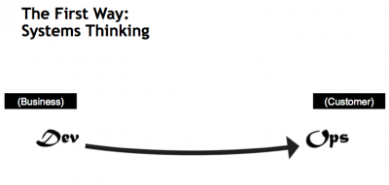
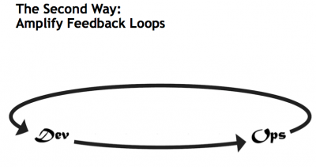
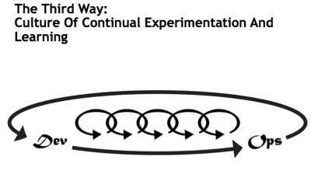
What is DevOps…
Infrastructure as Code (IaC)
Continuous Integration (CI)
Automated Testing
Application Performance Monitoring/Management (APM)
Continuous Deployment (CD)
Release Management
Configuration Management
DevOps Fundamentals
Advanced Monitoring
Capacity Management
Feature Flags
Self-Service Environments
Automated Recovery (Rollback & Roll-Forward)
Hypothesis Driven Development
Testing in Production – partial user base
Fault Injection
Usage Monitoring/Telemetry
A/B Testing (aka canary testing)
Gene Kim’s “3 ways”
The First Way emphasizes the performance of the entire system, as opposed to the performance of a specific silo of work or department — this as can be as large a division (e.g., Development or IT Operations) or as small as an individual contributor (e.g., a developer, system administrator).
The Second Way is about creating the right to left feedback loops. The goal of almost any process improvement initiative is to shorten and amplify feedback loops so necessary corrections can be continually made
The Third Way is about creating a culture that fosters two things: continual experimentation, taking risks and learning from failure; and understanding that repetition and practice is the prerequisite to mastery.
http://www.itproguy.com/devops-practices/
http://itrevolution.com/the-three-ways-principles-underpinning-devops/

Slide 13
Traditional vs modern dev-ops
Category | Traditional | Modern DevOps
Quality of code check-ins | Unknown | Validated through unit tests
Environment Creation/Configuration | Manual | Automated
Deployment Frequency | 1-2 months (or less frequent) | Deploy whenever needed, including several per day
App Deployment Process | Requires meetings and planning | Push-button deployment
Deployment validation | Manual | Automated
Monitoring | Minimal to none | Health and Performance monitoring
Dev and Ops relationship | Blame culture | Culture of trust

Slide 14
Containerization
ARM Template
2 Hosts
4 Instances of Container A
2 Instances of Container B
Container are… a technology that ENABLES and ACCELERATES DevOps
Abstract the unit of work from the VM
Lightweight, fast provisioning, density
Simplify application updates
Works with cluster managers for auto-scale capabilities
Container Host - 1
Container Host - 2
Container
A
Container
A
Container
A
Container
A
Container
B
Container
B
Orchestration Engine

Slide 15




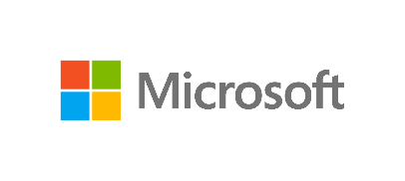
Cloud is a new way to think about a datacenter
I AM SPECIAL
WE ALL LOOK ALIKE
VIRTUAL
MACHINES
VM SCALE SETS
CONTAINER SERVICE
SERVICE FABRIC
Build on
Infrastructure Mindset
Build on
Platform Mindset
Ultimate Control
Traditional Model Cloud Model
Cost and Agility
System
Admin
Windows and Linux
.NET, Java, Python, PHP, Ruby, GO, Node.JS
Docker Swarm
Mesos, etc.,
Cloud Foundry,
Marathon, Deis, OpenShift etc.
Developer
Azure is Open at Every Layer
Notes:
Notes coming soon – please check back on http://aka.ms/opensource for latest version

Slide 16
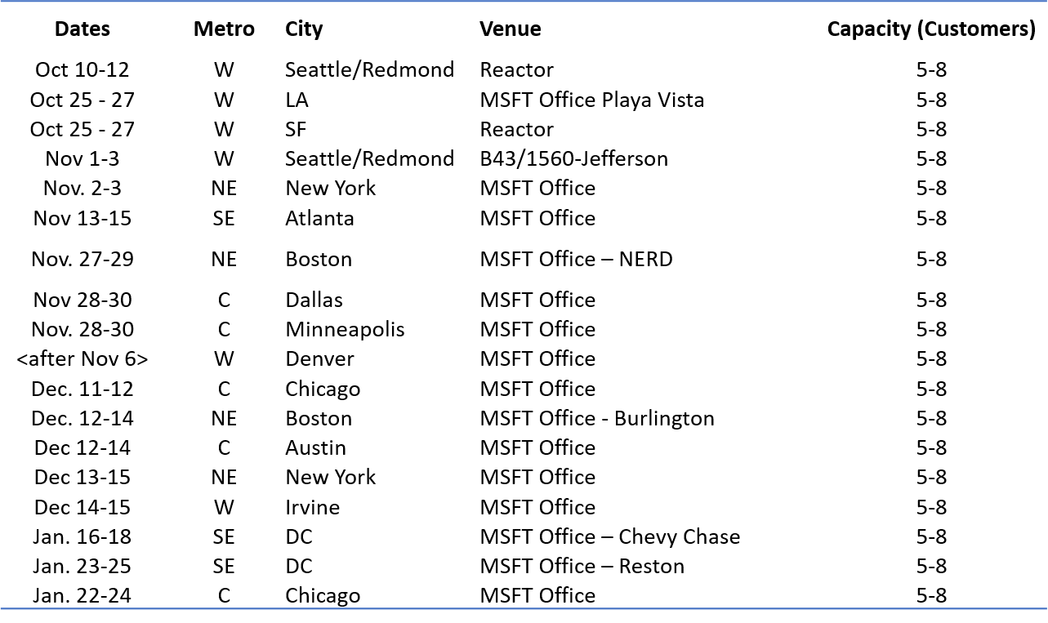
DevOps Journey
“There are many secrets to showing quick results with DevOps. Results, where the true value of DevOps can be realized in just a few weeks” – Dan Stolts, Chief Technology Strategist, Microsoft
Not Started?
Already started:
Feel you should be able to get results faster
It is too hard
Takes too long
There is too much bureaucracy
Event Schedule ➔
How to Join: Reach out to your Sales Team; cc dstolts@microsoft.com
Alert: Many pre-req’s
Let Microsoft show how to kick your journey into high gear.
Where you are executing at top speed with lower amounts of energy being consumed.

Slide 17
Kickstart Your DevOps Journey
Introductory Meeting [1.5 hours]
Quick review of pipeline: Feedback.. Production -> Planning/Ideation. This review will help us answer the following:
Identify primary tools, processes and perceived weaknesses if any
Define needed participants/roles to be included in VSM (and hack) - includes name, email address, tittle, role (Homework?).
Schedule VSM (Aug 31-Sept 1) & Hack October ????
If time, identify any training desired
VSM – Day 1-2
Around the room intro’s
Short DevOps Training
Whiteboard Value Stream Map
Working Lunch
Plan hack priority - {if needed}
Define Success
Identify expected outcomes
Homework – if needed
Lock hack dates
Training (Docker, VSTS, Azure, Hybrid, whatever) if needed and time permits
Hackfest
Day 1 - Setup Teams; Identify requirements, Identify scribe; Perform Training; Hack rest of day 😊
Day 2- Hack all day ☺ 3pm Team scrums
Day 3-? Hack all day ☺
Last Day
Morning Test process; tweak as needed
Document – outline will be provided; Teams can use to share their success with their leadership
Working Lunch
Afternoon Document; Create follow-up plan (future hacks, deploy in production, work on different part of pipeline, etc)
2:30-3:30pm; 10-15 mins team presentations to all hackers and Q&A from other hack teams
Provide Feedback using Event Feedback URL
Plan Project Phase II
Define Post hack Schedule
Leadership team discussions of projects and priorities
Plan continued hack schedule
4:30pm hack ends

Slide 18
Questions… Answered at Events
?
?
?
?
?
?
?
?
?
?
?
?
?
?
?
?
?
?
?
?
?

Slide 19
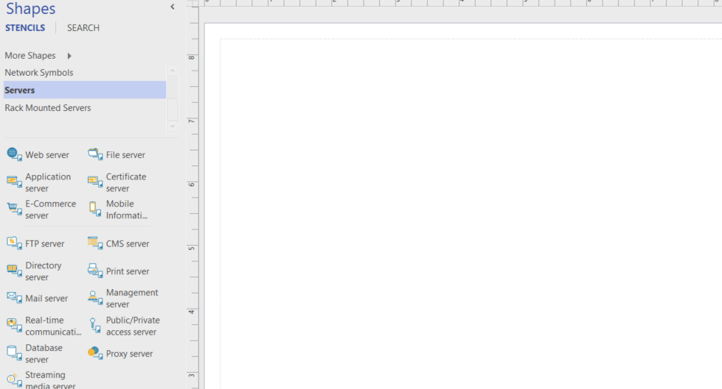
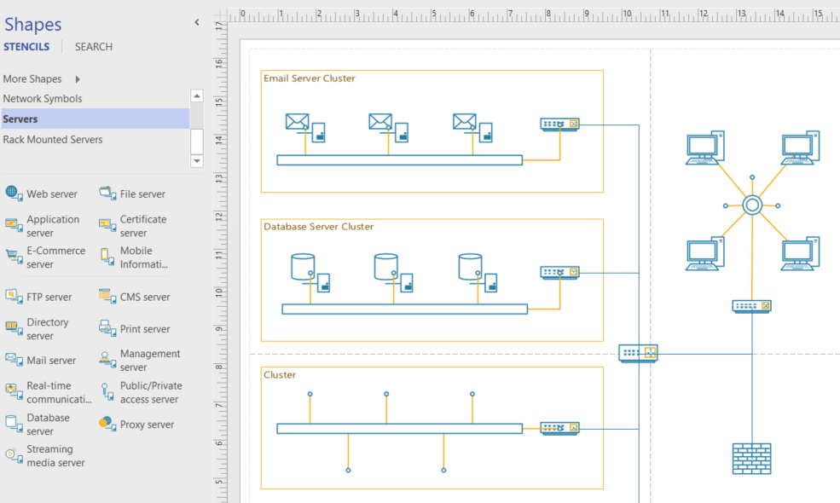
Azure..Like Visio, you start with a blank canvas…
Architect what is possible for your company. Solve Your Business Challenges with the Azure Cloud

Slide 20
Tips, Tricks and Field Experiences
Recognize Accomplishments
Finish a chapter, Finish a Lab, Watch a video, Read a white paper… All Accomplishments
Get Family On Board
Make your goals, their goals. Trip to Dave & Busters upon completion, ice cream shop for a chapter
Make the Decision… Get STARTED NOW!
Self, Career, Income, Stature
Value of Certification
Excuses
Excuses are Easy; Results are forever! Just Do IT!
Value of time
What is your time worth? When you are sitting in front of the tube, that is what it is costing you
Notes:
Tips, Tricks and Field Experiences Value of Certification: I want to make sure you are on board with the value of certification. Certification can offer many advantages including: getting a raise at your next review, preparing you for new job opportunities, increasing the likelihood your resume will be seen by the hiring manager, increasing your self confidence, increase you image (how people see you) in your business and in your social circles, lines on your resume, most hiring managers consider certification as part of their hiring criteria, you get experience while preparing for certification,…. and the list could go on and on. The fact of the matter is there is never any shortage of reasons why we should get certified. I am glad you have read this far… Make the decision to read this article in it’s entirety, then GET STARTED!!! Write down the reasons you want to obtain certification and look at them daily. Recognize Accomplishments: Recognize your accomplishments not matter how small. Feel good about the fact that you finished reading this article and realize that having done so has gotten you one step closer to obtaining your MCP in the Azure Cloud. Each time you finish something, even if it is just watching a 20 min video or reading a blog post that is relevant to the exam, recognize to yourself that it is a positive step in the right direction. Reflect back on why you want to do this in the first place. Get Family On Board: Often having family (spouse, kids, etc) on board with your goals and objectives will help you stay the course. Engage them, offer the kids a night out at Dave & Busters or an ice cream shop once you pass the exam. Show them your great study habits, maybe they will pick some of them up for their school studies. Excuses: Excuses for not getting certified are easy to come by… I do not have time, can’t concentrate because of the kids, tired when home from work, my boss does not care anyway, it will not help me in my job… and on and on… Give it up! Stop making excuses; stop procrastinating and make the decision to put your career in motion! Keep doing what you have been doing, and you will keep getting what you have always gotten. Value of time: Put a value on your time. What is your time worth? When I was a consultant billing out $250 an hour, that was the value I had on my time. Now it is often somewhat less. Now, during my busy season, I use a value of $100 per hour. During my slow season, when I am much less stressed and work fewer hours, I use a value of $50 per hour. During the summer, family time, the value shoots back up to $250. This may seam silly but it will help you prioritize your time. It will also help you justify purchases. When you consider purchasing a $40 book it will be a no brainer. Spending $40 will potentially save you dozens of hours of time because you will be studying exactly what you need to know, nothing more, nothing less. It may help you decide you should just be taking a class to get this behind you quickly. Even if you just use a value of $10 per hour, it is important to pick a value for your time! If you are broke and have a zero value for your time, fake it. Put a value on your time anyway it will help you prioritize. Even if it is only $1, is sitting in front of the tube watching a sitcom by yourself worth a dollar? Not usually, get up and pick up a book or watch a certification video instead! Dedicated Study time: Set time on the calendar every day or every week for preparation. Just like any other appointment, take the attitude that you have to be there at the scheduled time to perform the duties that are expected of you. Blocking the time on the calendar then sticking to it is likely the single best thing you can do to help you succeed. Figure out what works best for you. Maybe it is 30 mins every day at lunch? How about 45 hour every night from 8:15pm-9:00pm? Whatever time block works for you is great. Personally, I find the best time for me is in the morning before work. This is when I am the most alert and can absorb the most information. I tend to get into the office before others, so I leverage the quite time as my personal development time. Try it, go into the office 45 minutes early to see if that works for you. You have to stick with it though, if you do it once and get distracted, don’t give up, try it a few more times. If people bug you, put a sign up letting them know you will be available for questions at 9:00am or whatever time you actually start working. Personally, when I am cramming, I will often spend 3-4 hours a day. I suffer from insomnia so I have plenty of extra time in my day. I prioritize that time on preparation. Ultra Focus With Intent: When you sit down to study, don’t take it lightly. Stay hyper-focused on learning. Don’t let your mind wander. You are on a very important mission. That mission is to learn as rapidly as possible. If you do this you will find that you will retain far more information and you will be able to consume it much faster. Read Faster: You can read faster. Use your ultra focus, it is a must to achieve this one. While reading, move your finger across the page or the screen at a steady pace, do not stop your finger, make sure your eyes focus on the word over your finger. It is ok if you miss a word or two, DO NOT GO BACK! Then when you master that move your finger faster, then faster, then faster. Eventually, you will be able to do this without the use of your finger as an aid. Objective: Recognize your objective when you set out to take an exam. The objective should be to “Pass the Exam”. Kind of self explanatory right? Not… Some people think, and will tell you that you have to learn everything about the topic in order to pass the exam. Total crap! Learn what you have to learn to pass the test, then leverage that knowledge to learn more as you progress your career. Study Smart: I have studied for many exams and hold more certifications than I can put in my signature block. What I have found in preparing for all the exams I have taken is “it is easy to study the wrong thing”. You know, you go to a blog post or a white paper to get information about an exam and they are telling you to read some 380 page document or white paper. That is bogus, don’t waste you time. I would guess that if you did read that document, you may learn more and maybe get one or two more questions right. But at what cost? Better to cover the materials on the test than, everything there is to know about a topic. More on this later! Objective: Recognize your objective when you set out to take an exam. The objective should be to “Pass the Exam”. Kind of self explanatory right? Not… Some people think, and will tell you that you have to learn everything about the topic in order to pass the exam. Total crap! Learn what you have to learn to pass the test, then leverage that knowledge to learn more as you progress your career. Exam Reference Material: There is often plenty of exam reference material available. Often it is even free. I will point you to some of it later in this article. If you do not mind spending a bit of money, I strongly recommend you just start with an exam reference guide. This could be much faster than spending countless hours learning what may or may not be on the exam. I am personally not a fan of just studying exam questions. I do find them useful, I just find having more context around the topic helps me retain it. by all means, try the practice tests, they be be helpful for you. Practice & Experience: There is no substitute for practice other than maybe experience! Use the technology you are trying to learn. If you have the ability to use the technology in your job, even better! Take advantage of these opportunities. If the opportunities are not there, go out of your way to make opportunities. Think about how you might be able to use this technology in your job, then justify to yourself why it is important to understand the technology for your job. Most employers want their staff IT staff to keep up with technology. They often also will accept that you do it partially on work time. Especially if they know you are spending a bunch of personal time learning. Even if it is just setting up a lab environment, getting your hands dirty will go a very long way to you understanding the technology. Exam Objectives: Most exams (and all of Microsoft exams) have well documented Exam Objectives or Skills Measured. Use the Exam Objectives as a “list of things to learn”. Print out the exam objectives and check them off one at a time, as you search that topic and spend time learning it. For the cloud exam, I have done much of the work for you, you can just print this blog post. Like writing a book: I am in the process of writing a book on a certification exam. When writing a book on a topic, you do not automatically know everything there is to know about that topic. You are generally not in a situation where you know it all and want to write a book to share your vast knowledge on the subject. On the contrary, you may know a bunch about the topic, but to teach people everything they need to know to pass the test, you have to learn much, much more. The way I do this is using the Exam Objectives. I research & learn what I can on each exam objectives, teaching and writing as I go. One of the other things you do prior to writing a book is, take the test. Take the test: Take the test, get a feel for what is on it. Microsoft offers a “2nd shot” so you can take the test a second time for free. Once you have gone through all of the exam objectives one time quickly, take the test to see how you do. This will give you a report so you can see what you need to study. As you are studying you will remember exam questions so you will know the relevance. After you pass the exam, if you want to learn more, use the exam report to study the things you did not ace (if you are so inclined.) What Exam: Figuring out what is the best exam to take next is often a challenge. Really though, it does not matter. See https://www.microsoft.com/learning whichever exam you chose will likely prepare you for what is next in your professional life because getting certified will make you better at it! If you are a general or specialized IT person start with 70-533. If you are a developer, start with 70-532. If you are an architect or infrastructure designer start with 70-534. If you are not sure, start with 70-533. Whatever you do, just start NOW! Once you pass the first cloud exam, go back and study the next one. Then repeat until you have passed them all. By then you should have caught the bug (the high that comes with a great accomplishment) and you will pick another topic and repeat! - See more at: http://itproguru.com/expert/2015/03/azure-cloud-certification-jump-start-70-532-70-533-70-534-exam-preparation/#sthash.sDikFZa4.dpuf

Slide 21
Tips, Tricks and Field Experiences
Practice & Experience
NO SUBSTITUTE! Do the labs; Azure @ Work
Take the test
2nd shot? Much easier after you take it because you know where you are weak ☺
Ultra Focus With Intent
After you pass the test, you can work on learning more and developing your career
Objective – Pass the Exam!
Don’t let your mind wander; You are on a mission to learn FAST!
Excuses
Excuses are Easy; Results are forever! Just Do IT!
Value of time
Dedicated Study time
30 mins Day/night Pick a time; make it happen!
What is your time worth? When you are sitting in front of the tube, that is what it is costing you
Read Faster
DO NOT GO BACK!
Use your finger, keep it moving make eyes follow

Slide 22
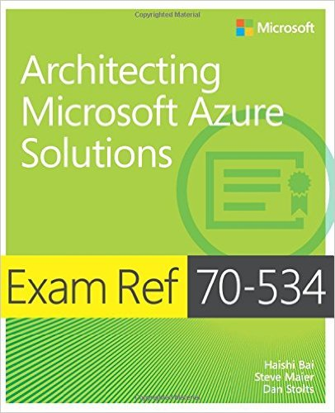
Event Notifications – Http://ITProGuru.com/join Example: Azure Certification Jump Start 70-534 Architecting Microsoft Azure Solutions
Brought to you By:
@ITProGuru
Microsoft
#1 Design Azure Resource Manager (ARM) networking (5–10%)
Design Azure virtual networks - Extend on-premises
Describe Azure VPN and Express Route architecture and design
#2 Secure resources (20–25%)
Secure resources by using managed identities
Secure resources by using managed identities
Secure resources by using identity providers
Identify an appropriate data security solution
Design a role-based access control (RBAC) strategy
Manage security risks by using an appropriate security solution
#3 Design an application storage and data access strategy (5–10%)
Design data storage
Select the appropriate storage option
#4 Design advanced applications (20–25%)
Create compute-intensive applications
Create long-running applications
Integrate Azure services in a solution
Implement messaging applications
Implement applications for background processing
Design connectivity for hybrid applications
#5 Design Azure Web and Mobile Apps (5–10%)
Design Web Applications
Design Mobile Applications
#6 Design a management, monitoring, and business continuity strategy (20–25%)
Design a monitoring strategy
Describe Azure business continuity/disaster recovery (BC/DR) capabilities
Design a disaster recovery strategy
Design Azure Automation and PowerShell workflows
Describe the use cases for Azure Automation configuration
#7 Architect an Azure Compute infrastructure (10–15%)
Design ARM Virtual Machines (VMs)
Design ARM template deployment
Design for availability
+ Bonus: Containers
Join EVENTS Mailing List NOW!
http://www.amazon.com/dp/0735697442/ref=rdr_ext_tmb
Other Event Plans:
DevOps, Containers,
Application Pipeline,
MicroServices & More
ITProGuru.com/Join
Curriculum for Attendees
Notes:
http://aka.ms/70-534 – Once it goes live..
Learn what you need to know to become a certified Azure Solutions Architect. We will go through the lessons found in the book 70-534 Architecting Microsoft Azure Solutions. We will wrap things up with our speakers (and authors of the book) doing a book signing so bring your copy of the book.
70-534 Introduction
Exam Tips and Tricks
Design an advanced application (15–20%)
Design websites (15–20%)
Design a management, monitoring, and business continuity strategy (15–20%)
Design Microsoft Azure infrastructure and networking (15–20%)
Secure resources (15–20%)
Design an application storage and data access strategy (15–20%)
Field Experiences
Book Signing – Authors Dan Stolts, Steve Maier

Slide 23



TechNet Virtual Labs
Deep technical content and free product evaluations
Hands-on deep technical labs
Free, online, technical courses
At the TechNet Evaluation Center you can download free, trial versions of Microsoft software, with no feature limits. Dozens of trials are available – all at no cost.
Try Windows Server 2012 R2 for up to 180 days. Download the Windows 8.1 Enterprise 90-day evaluation. Or try Microsoft Azure at no-cost for up to 90 days.
Microsoft Hands On Labs offer virtual environments that will take you through guided, technically deep product learning experience.
Learn at your own pace in labs that you can complete in 90 minutes or less. There is no complex setup or installation is required to use TechNet Virtual Labs.
Microsoft Virtual Academy provides free online training on the IT scenarios that are important to your company and your career.
Learn at your own pace and boost your IT skills with over 100 courses across more than 15 Microsoft technologies including Windows Server, Windows 8, Microsoft Azure, Office 365, virtualization, Windows Phone, and more.
Download Microsoft software trials today.
Find Hand On Labs.
Take a free online course.
Technet.microsoft.com/evalcenter
Technet.microsoft.com/virtuallabs
microsoftvirtualacademy.com

Slide 24
More Resources
Resource | Link
Virtual Academy Videos | https://mva.microsoft.com/product-training/microsoft-azure#!jobf=IT%20Pros&lang=1033
Various On-line training | https://www.microsoft.com/en-us/learning/azure-training.aspx
Visual Studio Developer Incentives | https://www.visualstudio.com/dev-essentials/
Azure training for AWS professionals | https://openedx.microsoft.com/courses/course-v1%3AMicrosoft%2BAzure213x%2B2016_T4/
Microsoft Azure for IT Pros Content Series | https://mva.microsoft.com/search/SearchResults.aspx#!q=Microsoft%20Azure%20for%20IT%20Pros%20content%20series&lang=1033
LinkedIn Learning Center | https://learning.linkedin.com/in/overview
Microsoft Learning
https://www.microsoft.com/en-us/learning/default.aspx

Slide 25
Operational Readiness
Coach Culbertson
Friendly Neighborhood Instructor
Directions Training
Damon Ronco
Azure Technology Solutions Professional
Microsoft

Slide 26
Design for Operations (10-15%)
Design an application monitoring and alerting strategy
Determine the appropriate Microsoft products and services for monitoring applications on Azure; define solutions for analyzing logs and enabling alerts using Azure Log Analytics; define solutions for analyzing performance metrics and enabling alerts using Azure Monitor; define a solution for monitoring applications and enabling alerts using Application Insights
Design a platform monitoring and alerting strategy
Determine the appropriate Microsoft products and services for monitoring Azure platform solutions; define a monitoring solution using Azure Health, Azure Advisor, and Activity Log; define a monitoring solution for Azure Networks using Log Analytics and Network Watcher service; monitor security with Azure Security Center
Design an operations automation strategy
Determine when to use Azure Automation, Chef, Puppet, PowerShell, Desired State Configuration (DSC), Event Grid, and Azure Logic Apps; define a strategy for auto-scaling; define a strategy for enabling periodic processes and tasks
Notes:
https://www.microsoft.com/en-us/learning/exam-70-535.aspx

Slide 27
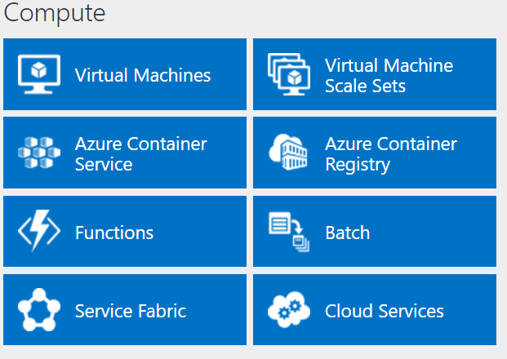
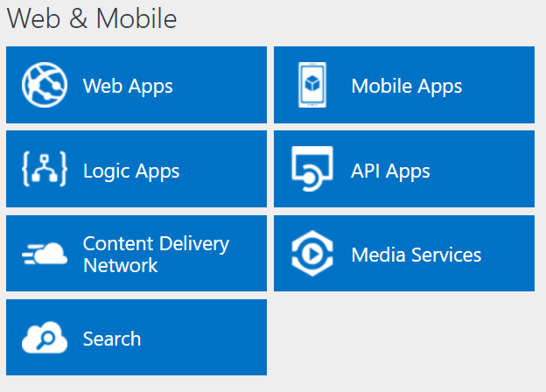
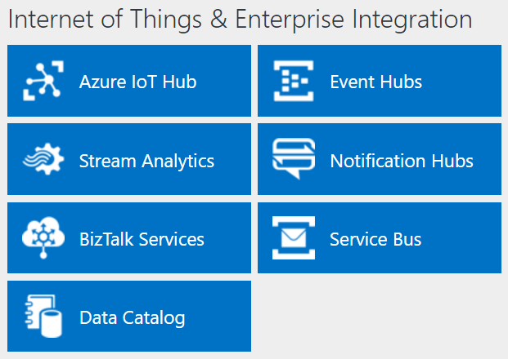
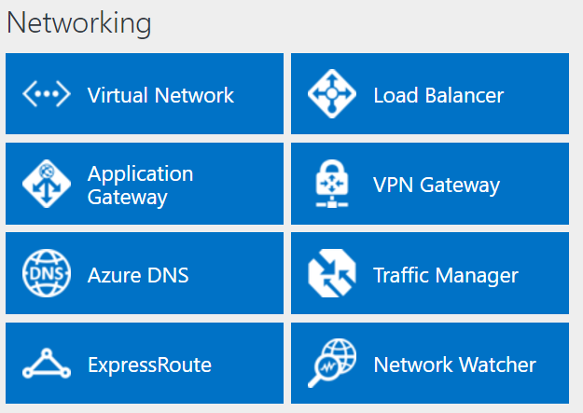
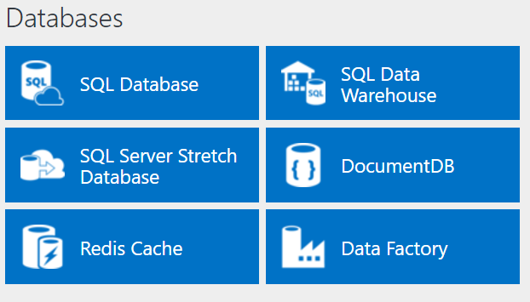
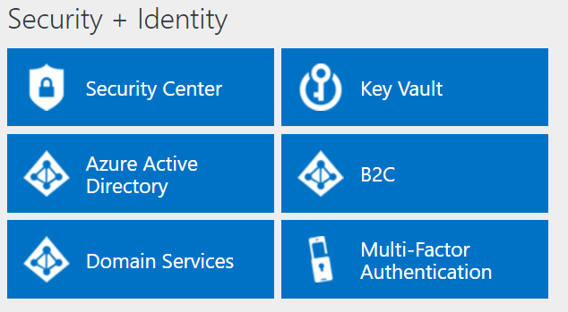
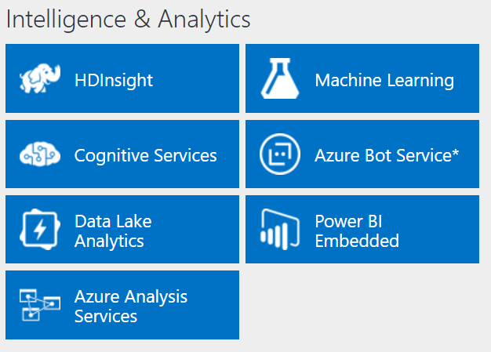
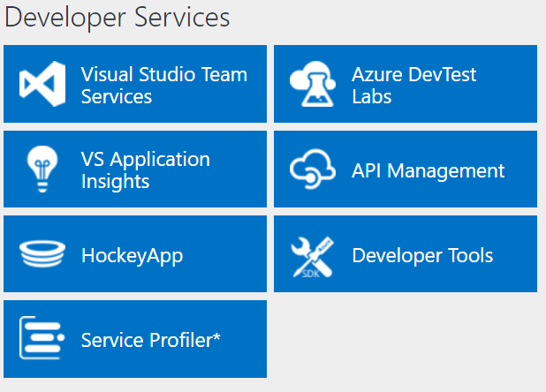
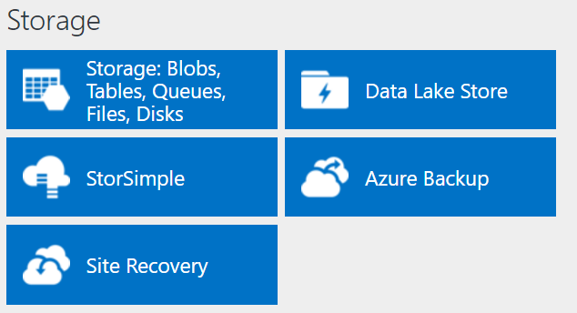
http://azureplatform.azurewebsites.net/
* Preview Services
Notes:
Preview Version 1.7 (2017-04-20)

Slide 28
Microsoft Products and Services – Platform Services
Azure Monitor
Enables basic monitoring for Azure service by allowing collection of Metrics, Activity Logs, and Diagnostic logs
Azure Service Health
Identifies any issues with Azure services
Azure Advisor
Recommendations for performance, security, high availability AND reduce your overall Azure spend.
Notes:
Determine the appropriate Microsoft products and services for monitoring applications on Azure
Azure monitoring services include the Azure Monitor, Advisor, Service Health, Activity Log, Dashboards, Metrics Explorer, Alerts, Log analytics and Application Insights. Other services are leveraged and tools and services are leveraged to visualize and remediate issues. Some of these include the Azure Portal, PowerShell, Azure CLI, REST APIs, Dashboards, Metrics Explorer, Analytics, Automation and Scheduler. These tools and services can be used together to effectively monitor and remediate issues found.
Basic Monitoring
Basic monitoring provides fundamental required monitoring across Azure resources. These services require minimal configuration and collect core telemetry that's leveraged by the premium monitoring services.
Azure Monitor enables basic monitoring for Azure service by allowing collection of Metrics, Activity Logs, and Diagnostic logs. For example, the Activity log will tell you when new resources are created or modified. Metrics are available that provide performance statistics for different resources and even the operating system inside of a virtual machine. You can view this data with one of the explorers in the Azure portal, send it to Log Analytics for trending and detailed analysis, or create alert rules to proactively notify you of critical issues. Azure monitor is a platform of services that allow for a single source for monitoring applications running in Azure. You can find a walkthrough of the Azure monitor at https://docs.microsoft.com/en-us/azure/monitoring-and-diagnostics/monitoring-get-started.
Azure Service Health identifies any issues with Azure services that might impact your application and also helps you plan for any scheduled maintenance.
Azure Advisor constantly monitors your resource configuration and usage telemetry to provide you recommendations based on best practices. Recommendations will help improve the performance, security, and high availability of your resources while looking for opportunities to reduce your overall Azure spend.

Slide 29
Microsoft Products and Services – Application / Infra
Application Insights
Application Monitoring; Availability plus performance and deep insights; on-premisis and in the cloud.
Log Analytics
Central Role in Azure Monitor: powerful query analytics on logs; complete picture IaaS and PasS
Service Map
Analyze VMs – Integrates events, management solutions, log analytics
Network Watcher
Scenario based: Network Performance Monitoring; DNS Traffic Analysis, more
Management Solutions
Packaged set of logic to monitor different workloads; Microsoft and third party
Notes:
Premium Monitoring Services
Premium Azure services provide rich capabilities for collecting and analyzing monitoring data. They build on basic monitoring and leverage common functionality in Azure and provide powerful analytics with collected data to give you unique insights into your applications and infrastructure. They present data within the context of particular scenarios targeted to different audiences.
Application Insights allows you to monitor availability, performance, and usage of your application whether it's hosted in the cloud or on-premises. By instrumenting your application to work with Application Insights, you can achieve deep insights allowing you to quickly identify and diagnose errors without waiting for a user to report them. With the information that you collect, you can make informed choices on your application's maintenance and improvements. In addition to the extensive tools for interacting with the data it collects, Application Insights stores its data in a common repository to leverage shared functionality such as alerts, dashboards, and deep analysis with the Log Analytics query language.
Log Analytics plays a central role in Azure monitoring by collecting data from a variety of resources into a single repository where it can be analyzed with a powerful query language. Application Insights and Azure Security Center store their data in the Log Analytics data store and leverage its analytics engine. This combined with data collected from Azure Monitor, management solutions, and agents installed on virtual machines in the cloud or on-premises allow you to form a complete picture of your entire environment.
Service Map provides insight into your IaaS environment by analyzing virtual machines with their different processes and dependencies on other computers and external processes. It integrates events, performance data, and management solutions in Log Analytics so that you can view this data in the context of each computer and its relation to the rest of your environment. Service Map is similar to the application map in Application Insights but focuses on the infrastructure components supporting your applications.
Network Watcher provides scenario-based monitoring and diagnostics for different network scenarios in Azure. It stores data in Azure metrics and diagnostics for further analysis and works with the following network monitoring solutions for monitoring various aspects of your network:
Network Performance Monitor (NPM) is a cloud-based network monitoring solution that monitors connectivity across public clouds, data centers and on-premises environments
ExpressRoute Monitor is an NPM capability that monitors the end-to-end connectivity and performance over ExpressRoute circuits.
Traffic Analytics provides visibility into user and application activity on your cloud network.
DNS Analytics provides security, performance and operations related insights, based on DNS servers.
Management solutions are packaged sets of logic that provide insights for a particular application or service. They rely on Log Analytics to store and analyze the monitoring data they collect. Management solutions are available from Microsoft and partners that provide monitoring for various Azure and third-party services. Example of monitoring solutions include Container Monitoring which helps you view and manage your container hosts and Azure SQL Analytics which collects and visualizes performance metrics for SQL Azure databases.

Slide 30
Microsoft Product and Services - Shared
Shared = Shared by multiple services
Azure Alerts
Proactive Notification; webhooks
Azure Dashboards
Visual representation of data
Metrics Explorer
Visualization of metrics; can send metrics to Log Analytics
Activity Logs
Provides (logs) data on services; including errors
Notes:
Shared Functionality
The following Azure tools provide critical functionality to monitoring services. They are shared by multiple services allowing you to leverage common functionality and configurations across multiple services.
Azure Alerts proactively notify you of critical conditions and potentially take corrective action. Alert rules can leverage data from multiple sources including metrics and logs. They use Action Groups which contain unique sets of recipients and actions in response to an alert. Based on your requirements, you can have alerts launch external actions using webhooks and integrate with your ITSM tools.
Azure Dashboards provides visual representations of monitoring data. Dashboards allow you to combine different kinds of data into a single pane in the Azure portal and share with other Azure users. For example, you could create a dashboard that combines tiles showing a graph of metrics, a table of activity logs, a usage chart from Application Insights, and the output of a log search in Log Analytics. You can also export Log Analytics data to Power BI to take advantage of additional visualizations and also to make the data available to others within and outside of your organization.
Metrics Explorer provides visualization of metrics. Metrics are numerical values generated by Azure resources that help you understand the operation and performance of the resource. You can send metrics to Log Analytics for analysis with data from other sources.
Activity Logs provide data about the operation of Azure resources. This includes such information as configuration changes to the resource, service health incidents, recommendations on better utilizing the resource, and information related to autoscale operations. You can view logs for a particular resource on its page in the Azure portal or view logs from multiple resources in Activity Log Explorer. You can also send Activity logs to Log Analytics so they can be analyzed with data collected by management solutions, agents on virtual machines, and other sources

Slide 31
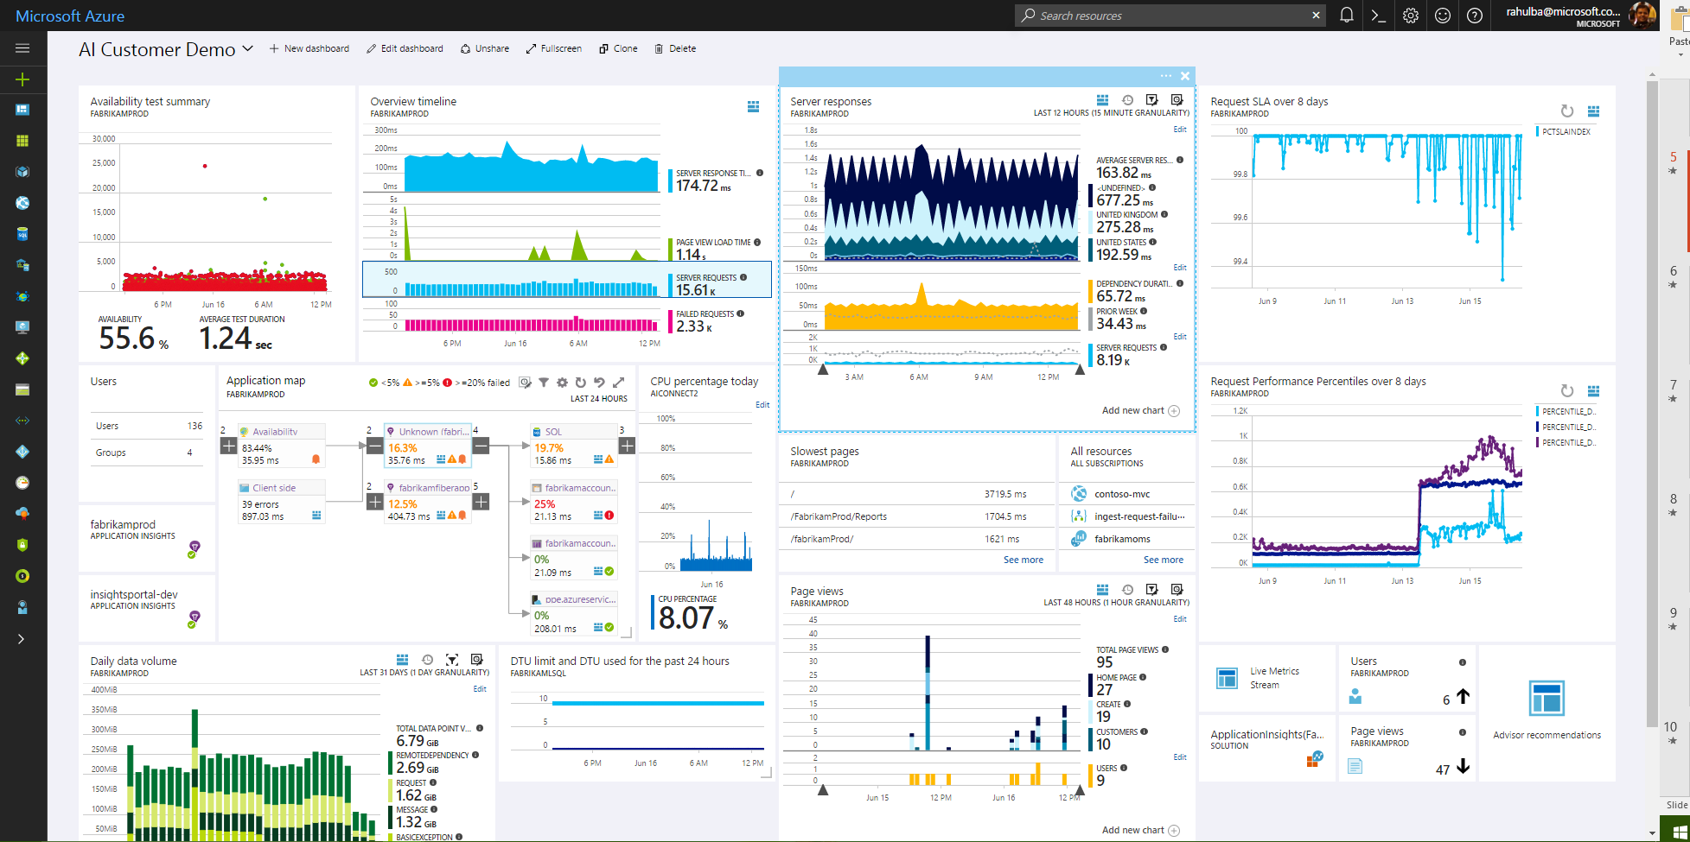
Azure Application Insights
Health Check
Monitor & Optimize
Detect & Debug
Data Analytics
Take Actions
Export & Correlate
DevOps Workflows
Customer Insights

Slide 32
Application Insights
Detect and diagnose issues in Web apps and services
Alerts through email or webhooks
Diagnose exceptions and performance issues
Perform root cause analysis and initiate azure automation runbook
Live application monitoring
HTTP metrics, Dependency (SQL) response times, Log tracing, View and Session counts, Server performance, Availability tests
Notes:
Application Insights is an extensible Application Performance Management (APM) service for web developers on multiple platforms.
Use it to monitor your live web application. It will automatically detect performance anomalies.
It includes powerful analytics tools to help you diagnose issues and to understand what users actually do with your app.
It's designed to help you continuously improve performance and usability. It works for apps on a wide variety of platforms including .NET, Node.js and J2EE, hosted on-premises or in the cloud. It integrates with your devOps process, and has connection points to a variety of development tools.
Request rates, response times, and failure rates
Performance counters from your Windows or Linux server machines, such as CPU, memory, and network usage.
Page views and load performance - reported by your users' browsers.
Dependency rates, response times, and failure rates - Find out whether external services are slowing you down.
https://docs.microsoft.com/en-us/azure/application-insights/app-insights-overview

Slide 33






Application Insights Ecosystem
Ingestion
Exploration
Export & Correlation
Application Insights
Microsoft Azure Portal
OMS Connector
Power BI
Open Source SDKs
Status Monitor
Azure Extensions
Azure Monitor
Application Map
Live Metrics Stream
Profiler & Debugger
Microsoft Azure dashboards
Blob storage
Visual Studio Team Services
SCOM MP Open Schema
Visual Studio IDE
Analytics Portal
Data Access APIs
Support
ASP.NET
ASP.NET Core
Java - J2EE
Windows Desktop
WCF
JavaScript
Node.JS
PHP
Python
Ruby
Angular
Docker
Kubernetes
Dynamics CRM
Azure Web Apps
Azure Cloud Services
Azure VMs
Azure Functions
Azure Service Fabric
Glimpse
Spring
Log4Net/NLog
Log4J/Logback
System.Diagnostics
Semantic Logging (SLAB)
ETW/EventSource
LogStash
Collectd
Concrete
Drupal
Joomla
SharePoint
WordPress
Orchard
OSS/Public Endpoints
…

Slide 34
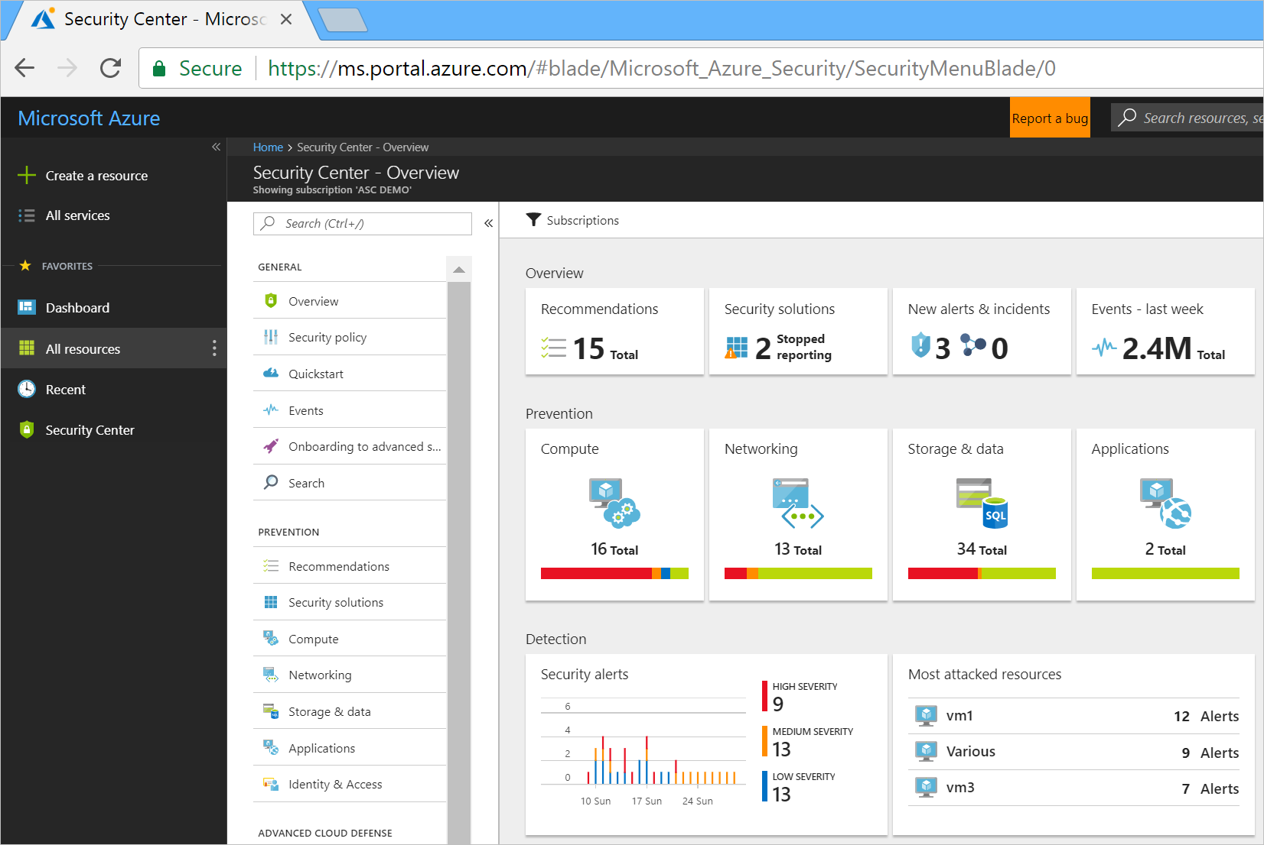
Azure Security Center
https://docs.microsoft.com/en-us/azure/security-center/security-center-intro
Notes:
https://docs.microsoft.com/en-us/azure/security-center/security-center-intro
Centralized policy management – Ensure compliance with company or regulatory security requirements by centrally managing security policies across all your hybrid cloud workloads.
Continuous security assessment – Monitor the security of machines, networks, storage and data services, and applications to discover potential security issues.
Actionable recommendations – Remediate security vulnerabilities before they can be exploited by attackers with prioritized and actionable security recommendations.
Advanced cloud defenses – Reduce threats with just in time access to management ports and whitelisting to control applications running on your VMs.
Prioritized alerts and incidents - Focus on the most critical threats first with prioritized security alerts and incidents.
Integrated security solutions - Collect, search, and analyze security data from a variety of sources, including connected partner solutions.

Slide 35
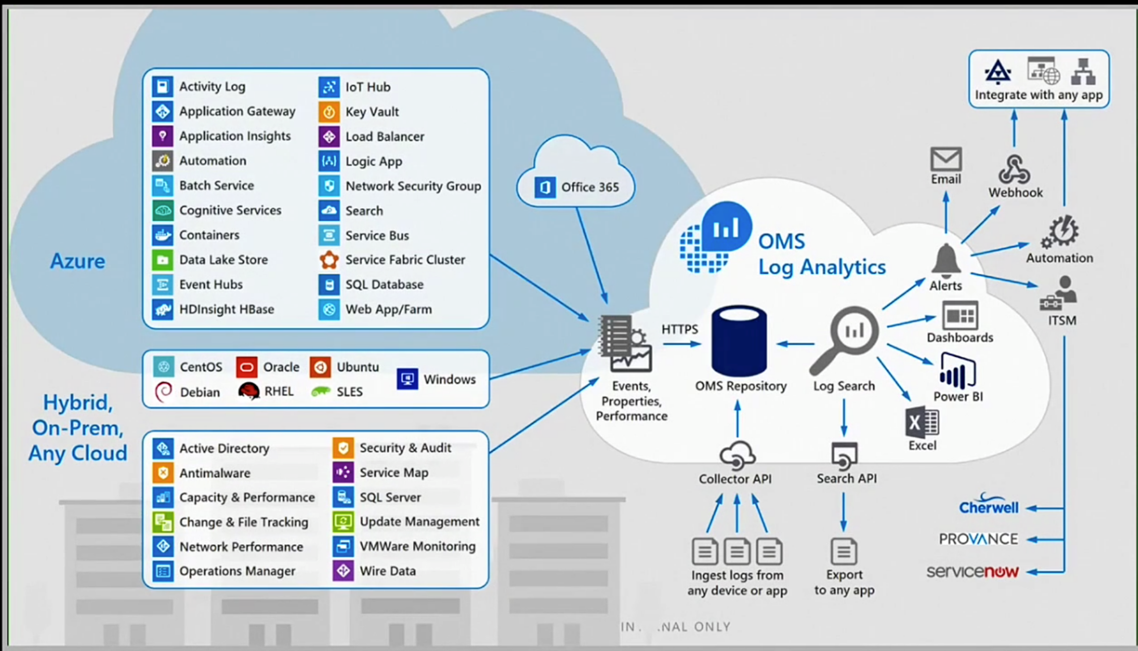
Azure Log Analytics
Notes:
The core functionality of OMS is provided by a set of services that run in Azure.
Each service provides a specific management function, and you can combine services to achieve different management scenarios
https://docs.microsoft.com/en-us/azure/operations-management-suite/operations-management-suite-overview

Slide 36
Azure Automation
PowerShell & PS Workflow Engines
Use your existing PS scripts
Checkpoint/Parallel if needed
Runbooks, Modules
Author PS, PSWF, Graphical runbooks
Gallery – Runbooks, modules
Extensibility, integration
Assets
Secure, global store for variables, credentials, …
Schedules
Jobs
Troubleshoot/audit via job history
PowerShell DSC
Configurations, Pull service
Node Management & Reporting
Hybrid Runbook Workers
Install on any machine
Secure, only outbound ports
Webhooks
URL to start runbook remotely
Integration
Azure Automation
Orchestrator
Hybrid Worker
SCO
SMA
Hyper-V
VMWare
OpenStack

Slide 37
Desired State Configuration (DSC)
Install or remove windows roles and features
Running Windows PowerShell scripts
Managing registry settings
Managing files and directories
Starting, stopping, and managing processes and services
Managing groups and user accounts
Deploying new software
Managing environment variables
Discovering the actual configuration state on a given node
Fixing a configuration that has drifted away from the desired state

Slide 38
Demo –Azure Security Center and other Assorted Tools and Toys

Slide 39
Compute Infrastructure
Coach Culbertson
Friendly Neighborhood Instructor
Directions Training
Damon Ronco
Azure Technology Solutions Professional
Microsoft

Slide 40
Design Compute Infrastructure (20-25%)
From https://www.microsoft.com/en-us/learning/exam-70-535.aspx
Design solutions using virtual machines
Design VM deployments by leveraging availability sets, fault domains, and update domains in Azure; use web app for containers; design VM Scale Sets; design for compute-intensive tasks using Azure Batch; define a migration strategy from cloud services; recommend use of Azure Backup and Azure Site Recovery
Design solutions for serverless computing
Use Azure Functions to implement event-driven actions; design for serverless computing using Azure Container Instances; design application solutions by using Azure Logic Apps, Azure Functions, or both; determine when to use API management service
Design microservices-based solutions
Determine when a container-based solution is appropriate; determine when container-orchestration is appropriate; determine when Azure Service Fabric (ASF) is appropriate; determine when Azure Functions is appropriate; determine when to use API management service; determine when Web API is appropriate; determine which platform is appropriate for container orchestration; consider migrating existing assets versus cloud native deployment; design lifecycle management strategies
Design web applications
Design Azure App Service Web Apps; design custom web API; secure Web API; design Web Apps for scalability and performance; design for high availability using Azure Web Apps in multiple regions; determine which App service plan to use; design Web Apps for business continuity; determine when to use Azure App Service Environment (ASE); design for API apps; determine when to use API management service; determine when to use Web Apps on Linux; determine when to use a CDN; determine when to use a cache, including Azure Redis cache
Create compute-intensive application
Design high-performance computing (HPC) and other compute-intensive applications using Azure Services; determine when to use Azure Batch; design stateless components to accommodate scale; design lifecycle strategy for Azure Batch
Notes:
As you can see, we have A LOT to cover so, please jot down your questions and hold them to the end.
https://www.microsoft.com/en-us/learning/exam-70-535.aspx

Slide 41

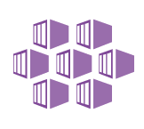



Azure: The Power Of Choice
Compute
Virtual Machines
Container Service
Service Fabric
App Service
Functions
More Control
Focus on the App
Customer-managed
(IaaS)
Platform-managed
(PaaS)
Code-only
(serverless)
Notes:
Azure provides several cloud-based compute offerings to run your application so that you don't have to worry about the infrastructure details.
You can easily scale up or scale out your resources as your application usage grows. Azure offers services that cover the spectrum—from providing infrastructure-as-a-service (IaaS) to give you full control over your application hosting, through platform-as-a-service (PaaS) where the services are hosted for you, to true serverless hosting where all you need to do is write your code.

Slide 42
Azure Resource Manager (ARM)
All services offered as ARM resources
Consistent model for creating/managing Azure resources
Based on declarative templates
Resources are managed in resource groups
Deployed together
Managed together
Provides RBAC support
Notes:
Demo: Resource Explorer

Slide 43
Azure Resource Manager Terminology
Resource
A manageable unit of Azure infrastructure
Examples: virtual machine, load balancer, storage account
Resource provider
A service that allows for creation and management of resources
Examples: Compute Resource Provider, Storage Resource Provider
Resource manager template
A declarative template for describing a resource group

Slide 44
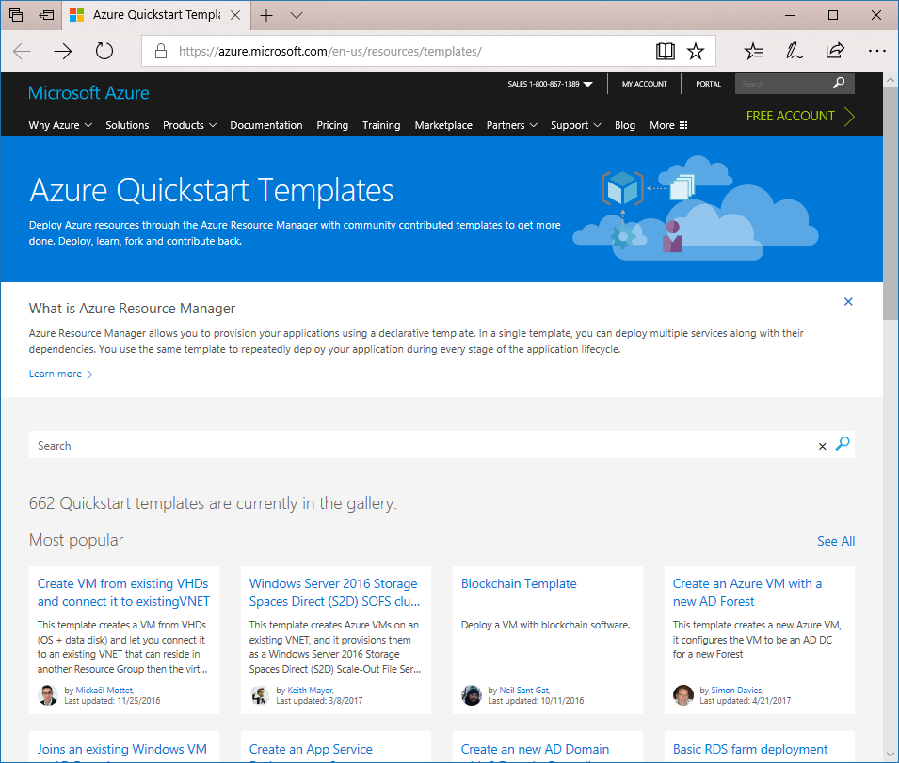
Reusable ARM Templates
https://azure.microsoft.com/en-us/resources/templates/

Slide 45
Security and Identity Solutions
Coach Culbertson
Friendly Neighborhood Instructor
Directions Training
Damon Ronco
Azure Technology Solutions Professional
Microsoft

Slide 46
Design Security and Identity Solutions (20%-25%)
Design an identity solution
Design AD Connect synchronization; design federated identities using Active Directory Federation Services (AD FS); design solutions for Multi-Factor Authentication (MFA); design an architecture using Active Directory on-premises and Azure Active Directory (AAD); determine when to use Azure AD Domain Services; design security for Mobile Apps using AAD
Secure resources by using identity providers
Design solutions that use external or consumer identity providers such as Microsoft account, Facebook, Google, and Yahoo; determine when to use Azure AD B2C and Azure AD B2B; design mobile apps using AAD B2C or AAD B2B
Design a data security solution
Design data security solutions for Azure services; determine when to use Azure Storage encryption, Azure Disk Encryption, Azure SQL Database security capabilities, and Azure Key Vault; design for protecting secrets in ARM templates using Azure Key Vault; design for protecting application secrets using Azure Key Vault; design a solution for managing certificates using Azure Key Vault; design solutions that use Azure AD Managed Service Identity
Design a mechanism of governance and policies for administering Azure resources
Determine when to use Azure RBAC standard roles and custom roles; define an Azure RBAC strategy; determine when to use Azure resource policies; determine when to use Azure AD Privileged Identity Management; design solutions that use Azure AD Managed Service Identity; determine when to use HSM-backed keys
Manage security risks by using an appropriate security solution
Identify, assess, and mitigate security risks by using Azure Security Center, Operations Management Suite Security and Audit solutions, and other services; determine when to use Azure AD Identity Protection; determine when to use Advanced Threat Detection; determine an appropriate endpoint protection strategy
Notes:
https://www.microsoft.com/en-us/learning/exam-70-535.aspx

Slide 47
On-Premise Active Directory vs Azure AD
Active Directory On-Premise | Azure AD
Authentication Provider | Authentication Provider
Internal single customer directory service | Multi-customer public directory service
Hierarchical structure of: Users, Computers, Ous, Groups, Services | Flat structure of: Users and Groups
Group Policy and DNS data | NA
Can be accessed using LDAP | Can be accessed using Graph API
Primarily uses Kerberos for authentication | Authentication can use SAML, WS-Federation and Oauth
Can Join VM and computer to domain | Can’t join VMs and computer(Except Windows 10)
AD DS Forest, Trees, Domains e.g cloudapp.net | Azure AD Tenants eg. Contoso.onmicrosoft.com
Notes:
In MS Marketing Speak: “Azure Active Directory (Azure AD) is a comprehensive identity and access management cloud solution that gives you a robust set of capabilities to manage users and groups. It helps secure access to on-premises and cloud applications, including Microsoft web services like Office 365, and many non-Microsoft software as a service (SaaS) applications.”
Azure AD is not the same as AD Directory Services – ADDS (a.k.a. On-Prem AD)
Azure AD does not…
Support Group Policy
Support Organizational Units or Computer objects
Support forests or trusts
Flat structure of users and groups
serves as the foundation of Azure’s authentication and authorization functionality
Think UNIX /etc/passwd and /etc/group files
Azure ADDS does exist but is outside the scope of this presentation

Slide 48
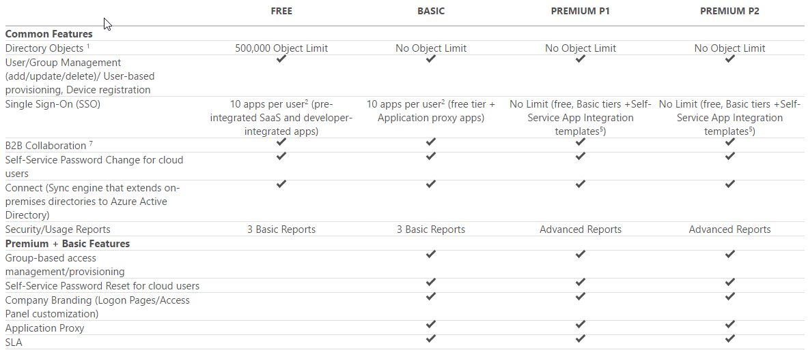
Azure AD Edition Features
https://azure.microsoft.com/en-us/pricing/details/active-directory/
Notes:
4 ”editions” of AzureAD
Free is included with any Azure subscription, but you can add paid capabilities using the Azure Active Directory Basic, Premium P1, and Premium P2 editions.
Azure Active Directory Basic
Designed for task workers with cloud-first needs
Provides cloud centric application access and self-service identity management solutions
Azure Active Directory Application Proxy (to publish on-premises web applications using Azure Active Directory
SLA of 99.9 percent uptime.
Azure Active Directory Premium P1
Designed to empower organizations with more demanding identity and access management needs
Adds feature-rich enterprise-level identity management capabilities
Enables hybrid users and seamless on-premises and cloud access
Microsoft Identity Manager (an on-premises identity and access management suite)
Provides cloud write-back capabilities enabling solutions like self-service password reset for your on-premises users.
Azure Active Directory Premium P2
Designed with advanced protection for all your users and administrators
Adds Identity Protection and Privileged Identity Management
Leverages billions of signals to provide risk-based conditional access to your applications and critical company data
Test focuses on what is available in the different offerings/SKUs.
As an architect it’s important to know the application/solution requirements and select the proper edition
Know what features/functionality is included by specific levels/editions
You don’t want to buy Premium “just because”
So what are the differences?
Reference(s):
https://azure.microsoft.com/en-us/pricing/details/active-directory/
https://docs.microsoft.com/en-us/azure/active-directory/active-directory-whatis

Slide 49
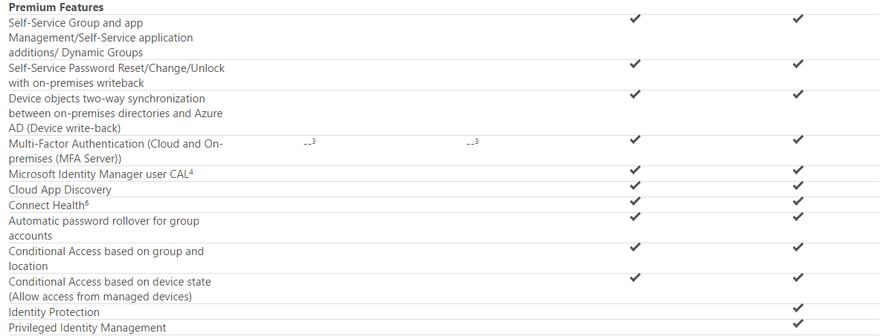
Azure AD Premium Features
https://azure.microsoft.com/en-us/pricing/details/active-directory/
Notes:
Biggest difference between the Premium offerings is the inclusion of Identity Protection and Privileged Identity Management in P2
Know the difference between Basic and Premium
Must be able to answer “what edition supports _____ “
Multiple selections
Reference(s):
https://azure.microsoft.com/en-us/pricing/details/active-directory/

Slide 50
Azure AD Connect
Connects your on-prem AD infrastructure to Azure
Composed of 3 components
Sync Services
Replicates user/group information between On-Prem and Azure
ADFS (optional)
Addresses complex deployments, such as domain join SSO, enforcement of AD sign-in policy, and smart card or 3rd party MFA.
Health
Robust monitoring and provide a central location to view activity
Notes:
Azure AD Connect is the umbrella technology/name for the components that connect your on-prem AD infrastructure to Azure.
Basically it integrates your on-premises directories with Azure Active Directory, thus providing a common identity for users of Office 365, Azure, and 3rd party SaaS applications with Azure AD Integration.
3 Components:
Synchronization - This component is responsible for creating users, groups, and other objects. It is also responsible for making sure identity information for your on-premises users and groups is matching the cloud.
ADFS (optional) - ADFS stands for Active Directory Federation Services and is an optional part of Azure AD Connect. Federating Azure with an on-prem ADFS environment allows organizations to address complex deployments and provides more granular security controls such as password policies, scheduled login times, or smart card/3rd party MFA.
Health Monitoring - Azure AD Connect Health can provide robust monitoring and provide a central location in the Azure portal to view this activity. For additional information, see Azure Active Directory Connect Health.
Reference(s):
https://docs.microsoft.com/en-us/azure/active-directory/connect/active-directory-aadconnect
https://docs.microsoft.com/en-us/azure/active-directory/connect/active-directory-aadconnectsync-whatis
https://docs.microsoft.com/en-us/azure/active-directory/connect/active-directory-aadconnect-topologies
https://docs.microsoft.com/en-us/azure/active-directory/active-directory-hybrid-identity-design-considerations-tools-comparison
https://docs.microsoft.com/en-us/azure/active-directory/connect/active-directory-aadconnectsync-feature-scheduler

Slide 51

Azure AD Connect
Notes:
Depiction of a basic AD connect deployment/topology
More complex deployments are possible
Note Azure AD Connect Topologies
Reference(s):
https://docs.microsoft.com/en-us/azure/active-directory/connect/active-directory-aadconnectsync-whatis
https://docs.microsoft.com/en-us/azure/active-directory/connect/active-directory-aadconnect-topologies
https://docs.microsoft.com/en-us/azure/active-directory/connect/active-directory-aadconnect
https://docs.microsoft.com/en-us/azure/active-directory/active-directory-hybrid-identity-design-considerations-tools-comparison
https://docs.microsoft.com/en-us/azure/active-directory/connect/active-directory-aadconnectsync-feature-scheduler

Slide 52
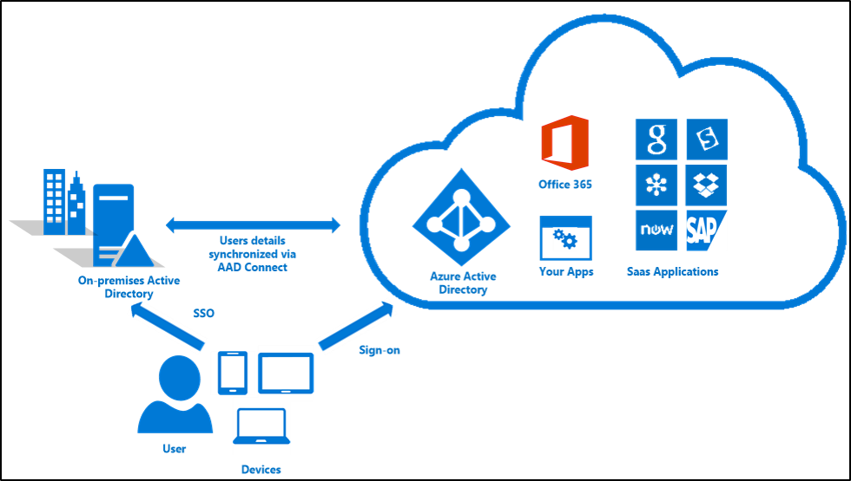
Azure AD Connect SSO
Notes:
NOT on the exam
Azure Active Directory Seamless Single Sign On (Azure AD Seamless SSO) provides true single sign on for users signing in on their corporate desktops connected on the corporate network. When enabled, users won't need to type in their passwords to sign in to Azure AD, and in most cases, even type in their usernames. This feature provides your users easy access to your cloud-based services without needing any additional on-premises components.
Seamless SSO is a free feature and you don't need any paid editions of Azure AD to use it. It remains free when the feature reaches general availability.
Supposedly GA as of 09/18/2017…not yet listed on Azure Updates page
Reference(s):
https://docs.microsoft.com/en-us/azure/active-directory/connect/active-directory-aadconnect-sso

Slide 53
Data and Storage
Damon Ronco
Azure Technology Solutions Professional
Microsoft
Coach Culbertson
Friendly Neighborhood Instructor
Directions Training

Slide 54
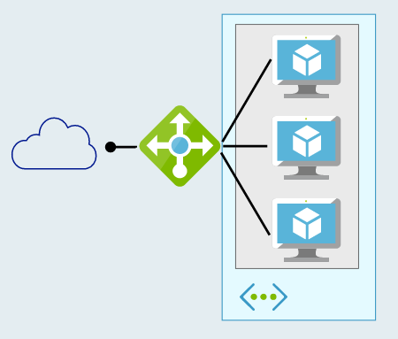
Defining High Availability 2 or more Azure VMs
Multiple VMs can be configured in an “availability set”
Workload is load balanced across the VMs
Azure SLA: 2 (or more) VMs in Availability Set:
99.95% (<22 min downtime p/month)
Includes
Planned downtime due to host OS servicing
Unplanned downtime due to physical failures
Doesn’t include servicing of guest OS or software inside (e.g. SQL)

Slide 55
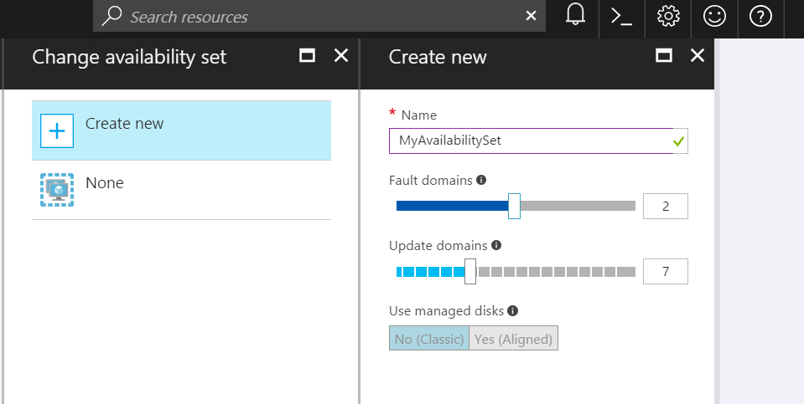
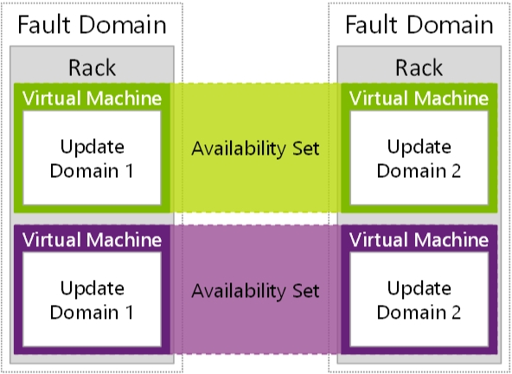
Availability Sets
Availability Sets are for Unplanned & Planned Maintenance
Fault Domains (2 default, some regions allow 3)
Upgrade Domains (5 default, 1-20 allowed)
Front with Load Balancer, App Gateway
Notes:
To provide redundancy to your application, we recommend that you group two or more virtual machines in an availability set.
Fault domain – collection of resources that may fail at the same time due to same root cause. Servers in same rack are part of same fault domain. A fault domain has a single point of failure. Place resources in separate fault domain so that they remain available in case of a failure
Update domain – logical collection of resources that can be updated at the same time. One update domain has updates applied at a time and may require rebooting. Pleace resources in separate update domains – it is automatic (indicate groups of virtual machines and underlying physical hardware that can be rebooted at the same time. )
One update domain has updates applied at a time
Availability set – can place vm’s in an availability set at creation or after deployment . Moving a vm in or out of availability set causes it to reboot
Fault domains
A fault domain is a logical group of underlying hardware that share a common power source and network switch, similar to a rack within an on-premises datacenter. As you create VMs within an availability set, the Azure platform automatically distributes your VMs across these fault domains. This approach limits the impact of potential physical hardware failures, network outages, or power interruptions.+
Update domains
An update domain is a logical group of underlying hardware that can undergo maintenance or be rebooted at the same time. As you create VMs within an availability set, the Azure platform automatically distributes your VMs across these update domains. This approach ensures that at least one instance of your application always remains running as the Azure platform undergoes periodic maintenance. The order of update domains being rebooted may not proceed sequentially during planned maintenance, but only one update domain is rebooted at a time.+
Managed Disk fault domains
For VMs using Azure Managed Disks, VMs are aligned with managed disk fault domains when using a managed availability set. This alignment ensures that all the managed disks attached to a VM are within the same managed disk fault domain. Only VMs with managed disks can be created in a managed availability set. The number of managed disk fault domains varies by region - either two or three managed disk fault domains per region. You can read more about these managed disk fault domains for Linux VMs or Windows VMs.
https://docs.microsoft.com/en-us/azure/virtual-machines/windows/manage-availability

Slide 56
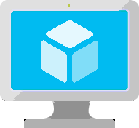
VM Scale Sets
High performance provisioning of 1000+ VMs
Auto-configuration at scale
Auto-scale based on schedule and resource metrics
Easy updates at scale
Simple Portal Integration
Notes:
So, VMs are great… but managing a lot of them individually can be hard. That’s where VM scale sets comes in..
The goal here is to enable management of like VMs as a group and make it easy to scale them in/out based on demand.

Slide 57
What is a Container?
VM
VM
VM
VM
App A
App A
App B
Container
Container
Container
App A
App B
App C
Guest OS
Guest OS
Guest OS
Bins/Libs
Bins/Libs
Bins/Libs
Container Engine
Guest OS
Hypervisor
Hypervisor
Host OS
Host OS
Server
Server
Notes:
VM
Hypervisor => VMWare, HyperV
Can do turtles, all the way down till your machine feels like it’s running from a potato

Slide 58
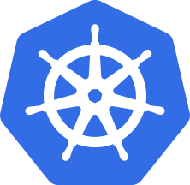
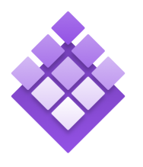

Azure Container Service
Azure Container Service
Making containers in Azure EZ!
Standard Docker tooling & API Support
Streamlined provisioning of K8S, DCOS, and Docker Swarm
Linux & Windows Server Containers
Azure & Azure Stack
Kubernetes
DC/OS
Swarm
Notes:
Running alongside excitement in containers has been excitement about container orchestrators.
The core job of the orchestrator is to take your containers and deploy them within a pool of compute infrastructure, then monitor their health and resource usage as they run, restarting or load balancing them as required.
Two popular OSS orchestrators are DC/OS and Swarm. DC/OS is developed by Mesosphere and is based on the Apache Mesos scheduler, whereas Swarm is built by Docker Inc.
So what is the role of ACS relative to the orchestrators? Well, historically they’ve been a pretty big pain to set up since each has a set of specific dependencies and expects a particular topology, including the deployment of a master node alongside a set of workers. ACS provides an easy way to configure an Azure environment that covers all of that and creates an environment that incorporates a number of best practices.
One important thing to note here is that EVERYTHING is OSS. You could easily take apps running on ACS and move them to another environment without changing anything you do.

Slide 59
Design Solutions by using Platform Services (10-15%)
Design for Artificial Intelligence Services
Determine when to use the appropriate Cognitive Services, Azure Bot Service, Azure Machine Learning, and other categories that fall under cognitive AI
Design for IoT
Determine when to use Stream Analytics, IoT Hubs, Event Hubs, real-time analytics, Time Series Insights, IoT Edge, Notification Hubs, Event Grid, and other categories that fall under IoT
Design messaging solution architectures
Design a messaging architecture; determine when to use Azure Storage Queues, Azure Service Bus, Azure Event Hubs, Event Grid, Azure Relay, Azure Functions, and Azure Logic Apps; design a push notification strategy for Mobile Apps; design for performance and scale
Design for media service solutions
Define solutions using Azure Media Services, video indexer, video API, computer vision API, preview, and other media related services
Notes:
https://www.microsoft.com/en-us/learning/exam-70-535.aspx

Slide 60
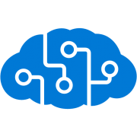
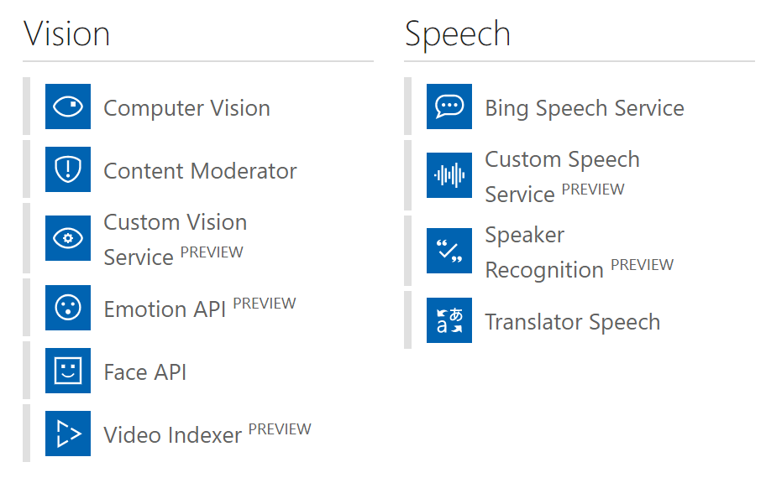
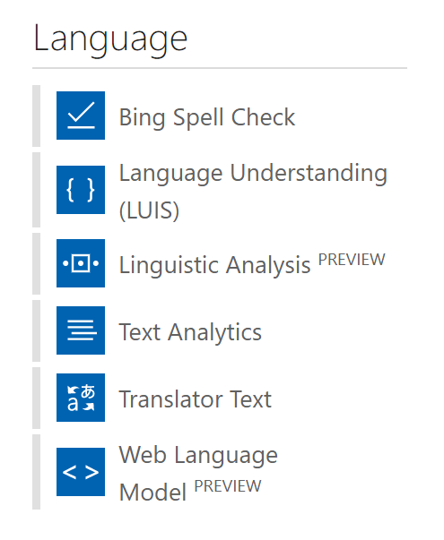
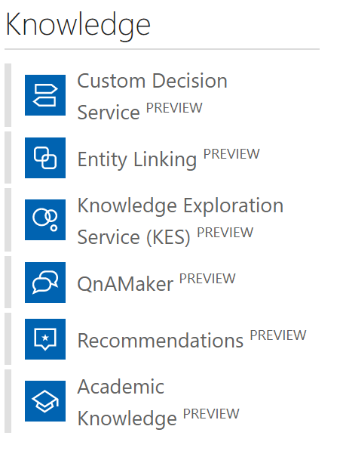
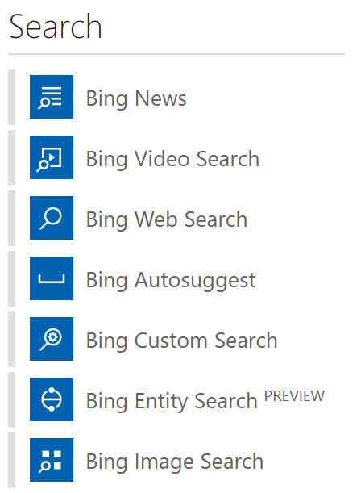
Cognitive Services
Notes:
29 comprehensive collection of intelligent and knowledge API to build smarter APPS
Available across platform
Easy integration with your experience
No background Machine learning

Slide 61
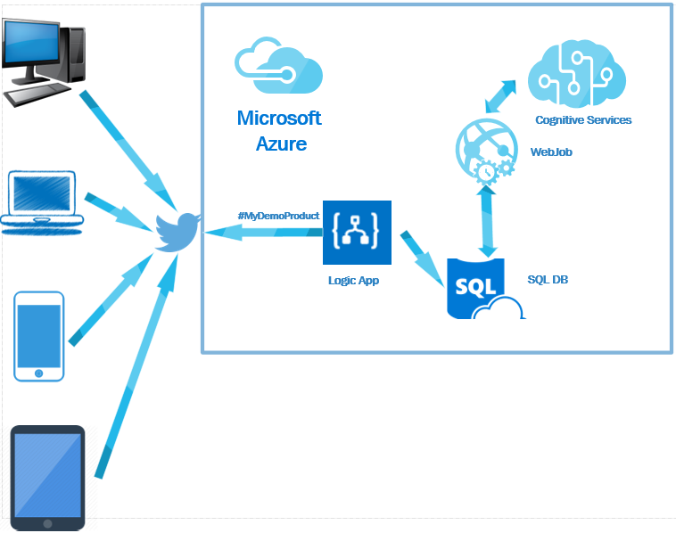
Notes:
Capture tweets from twitter or comments from Facebook and Figure out the sentiment of the tweets.
https://blogs.msdn.microsoft.com/biblog/2016/11/01/build-social-sentiment-analysis-solution-using-microsoft-azure-services/

Slide 62
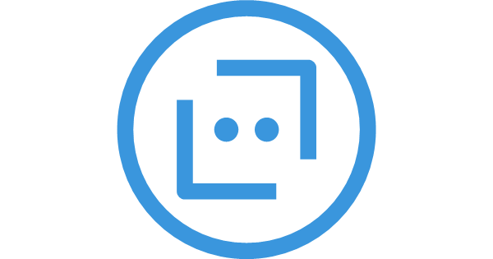
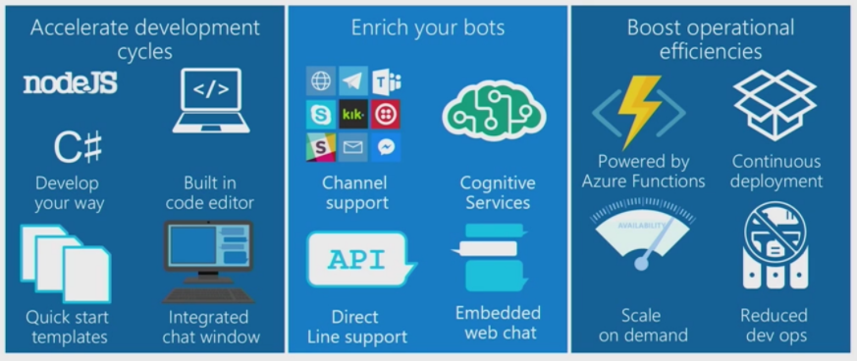
Bot Services
Notes:
Build, connect, deploy, and manage intelligent bots to interact naturally with your users on websites, apps, Cortana, Microsoft Teams, Skype, Slack, Facebook Messenger, and more. Get started quickly with a complete bot-building environment. You’ll pay only for what you use.

Slide 63

Stream Analytics
Instantly analyze data from all your IoT devices and gateways
Develop massively parallel Complex Event Processing (CEP) pipelines with simplicity
Start in seconds, scale instantly, pay per job
Build real-time dashboards in minutes
Enterprise grade availability, auditing and support
Notes:
An on-demand real-time analytics service to power intelligent action
Easily develop and run massively parallel real-time analytics on multiple IoT or non-IoT streams of data using simple SQL like language. Use custom code for advanced scenarios. With no infrastructure to manage, you can process data on-demand, scale instantly, and only pay per job.

Slide 64
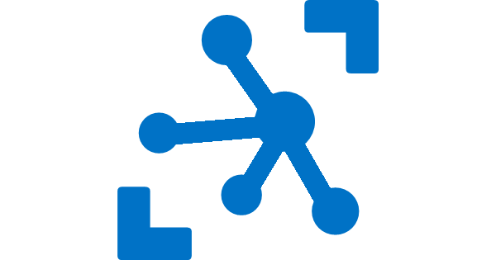
IoT Hub
Establish bi-directional communication with billions of IoT devices
Authenticate per device for security-enhanced IoT solutions
Register devices at scale with IoT Hub Device Provisioning Service
Manage your IoT devices at scale with device management
Notes:
Connect, monitor, and manage billions of IoT assets
Get started quickly
Register and provision IoT devices automatically
Connect and manage billions of IoT devices and assets
Establish reliable, bi-directional communication
Enhance the security of your IoT solutions
Ingest real-time data and upload files to the cloud

Slide 65

Time Series Insights
Find actionable insights in seconds
Start in seconds, scale in minutes
Create a global view of your IoT-scale data
Apply Time Series Insights to your apps and solutions
Access enterprise-grade security and support
Notes:
Time Series Insights
The best platform for storing and managing time-series data
Azure Time Series Insights is a fully managed analytics, storage, and visualization service for managing IoT-scale time-series data in the cloud. It provides massively scalable time-series data storage and enables you to explore and analyze billions of events streaming in from all over the world in seconds. Use Time Series Insights to store and manage terabytes of time-series data, explore and visualize billions of events simultaneously, conduct root-cause analysis, and to compare multiple sites and assets.

Slide 66
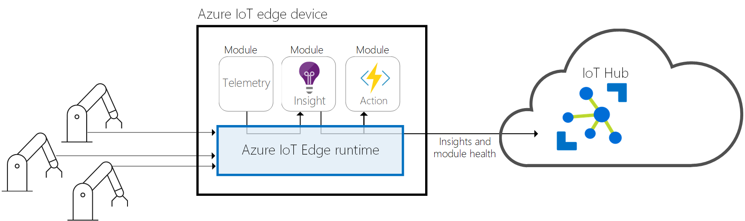
IoT Edge
Extend cloud intelligence to edge devices
Run artificial intelligence at the edge
Perform edge analytics
Deploy IoT solutions from cloud to edge
Manage devices centrally from the cloud
Operate with offline and intermittent connectivity
Enable real-time decisions
Connect new and legacy devices
Reduce bandwidth costs
Notes:
Extend cloud intelligence to edge devices
Run artificial intelligence at the edge
Perform edge analytics
Deploy IoT solutions from cloud to edge
Manage devices centrally from the cloud
Operate with offline and intermittent connectivity
Enable real-time decisions
Connect new and legacy devices
Reduce bandwidth costs

Slide 67
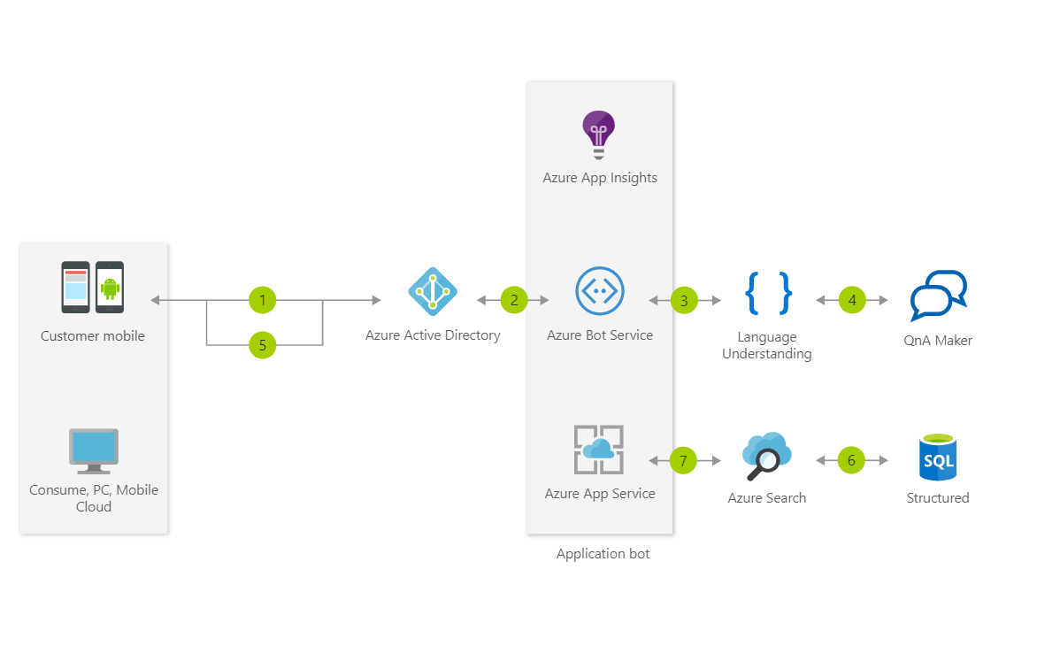
Notes:
This Informational Bot can answer questions defined in a knowledge set or FAQ using Cognitive Services QnA Maker and answer more open-ended questions using Azure Search

Slide 68

Service bus
PaaS with no Infrastructure management
Relay capabilities to build hybrid apps
Supports AMQP and common protocols such as HTTP
Contains Event Hub, a cloud scale telemetry ingress service.
Notes:
Service Bus is a multi-tenant cloud service
Microsoft Azure Service Bus is a reliable information delivery service. The purpose of this service is to make communication easier. When two or more parties want to exchange information, they need a communication facilitator.
AMQP Advanced Message Queuing Protocol

Slide 69
Service Bus Topic
S
R
Subs
Topic
S
R
R
R
S
R
One to many broadcasting scenarios
Filter messages
Use ReceiveBatch() or ReceiveBatchAsync() to receive a batch of messages

Slide 70
Service Bus Queue
S
R
S
Queue
R
S
R
Point to point communication
FIFO order guarantee
Supports Batch Receive and Batch Send

Slide 71
Event Hub
Ingest messages at scale at high throughput, high volume and low latency
Typical use cases are IOT and enterprise logging
Messages are durable for 7 days
No enterprise messaging features such as dead letter queue
Notes:
Azure Event Hubs is a highly scalable data streaming platform and event ingestion service, capable of receiving and processing millions of events per second. Event Hubs can process and store events, data, or telemetry produced by distributed software and devices. Data sent to an event hub can be transformed and stored using any real-time analytics provider or batching/storage adapters

Slide 72
Connectivity for Hybrid Applications
Azure Relay
Hybrid connections and WCF Relay are part of the Azure Relay service
Communicate with on-premises resources without opening a firewall port
Hybrid Connections support multi-platform scenarios.
Hybrid Connections can be used to connect to any TCP port including SQL DB’s and Web API’s.
WCF Relay can communicate with WCF services and .NET Framework only.
VPN
Connect an Azure Web App to on-premises via VPN.
VNET integration gives a multi tenant Web App Access to resources accessible by an Azure VNET.
App Service Environment (ASE) can be deployed into an Azure VNET for bidirectional access.
Notes:
The Azure Relay service facilitates hybrid applications by enabling you to securely expose services that reside within a corporate enterprise network to the public cloud, without having to open a firewall connection, or require intrusive changes to a corporate network infrastructure. Relay supports a variety of different transport protocols and web services standards.
Windows Communication Foundation

